Slide 1





NEXT GEN EMPLOYABILITY PROGRAM
Creating a future-ready workforce
Team Members
Student Name : Fathima Zulaikha
Student ID : au311121104022
College Name
Loyola-ICAM College of Engineering and Technology

Slide 2

CAPSTONE PROJECT SHOWCASE
Next Gen Employability Program
Project Title
MUSIC WEB APPLICATION USING DJANGO FRAMEWORK
Abstract | Problem Statement | Project Overview | Proposed Solution | Technology Used | Modelling & Results | Conclusion

Slide 3
Next Gen Employability Program
Abstract
Harmony is a dynamic music platform designed to cater to individual tastes and preferences. With its innovative technology, Harmony offers personalized playlists and recommendations, ensuring every user enjoys a unique listening journey. By leveraging data analytics and machine learning, Harmony stays ahead of musical trends, introducing users to emerging artists and genres before they hit the mainstream.
Harmony's intuitive interface makes music discovery effortless, allowing users to explore new sounds and create curated playlists with ease. Additionally, Harmony fosters a sense of community through social features, enabling users to connect with like-minded music enthusiasts and share their favorite tracks and discoveries.
With Harmony, music lovers can break free from the confines of traditional streaming services and immerse themselves in a world of endless musical possibilities. Whether you're seeking to expand your musical horizons or simply enjoy your favorite tracks, Harmony is your ultimate companion on the journey of musical exploration.
Source :

Slide 4
Next Gen Employability Program
Problem Statement
Existing music streaming platforms lack personalized recommendations and fail to keep users updated with emerging artists and genres, leading to a stagnant music discovery experience.
Current music streaming services often lack the ability for users to download their favorite songs for offline listening without a premium subscription, restricting access to music in areas with limited internet connectivity or data plans
Source :

Slide 5
Next Gen Employability Program
Project Overview
The project aims to develop a music streaming platform called Harmony, designed to provide users with a seamless and personalized music listening experience.
Harmony will offer a vast library of songs across various genres, allowing users to discover new music, create playlists, and interact with a community of music enthusiasts.
Key features include personalized recommendations, real-time trend analysis, the ability to create and share playlists, and free song downloads.
The platform will be accessible via web and mobile applications, ensuring users can enjoy their favorite
music anytime, anywhere.
Source :

Slide 6
Next Gen Employability Program
Proposed Solution
. Harmony is a free music streaming platform designed to revolutionize the way users discover and enjoy music.
With personalized recommendations, customizable playlists, and social features, Harmony offers a seamless and engaging music experience for all users.
By providing both online streaming and offline listening options, Harmony ensures convenient access to music anytime, anywhere.
With a focus on user personalization and community engagement, Harmony aims to enhance the music streaming experience for everyone, free of charge.
Source :

Slide 7
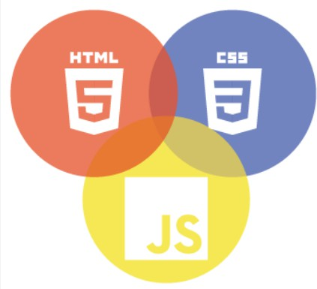

Next Gen Employability Program
Technology Used
Front-end
Back-end
Source :

Slide 8
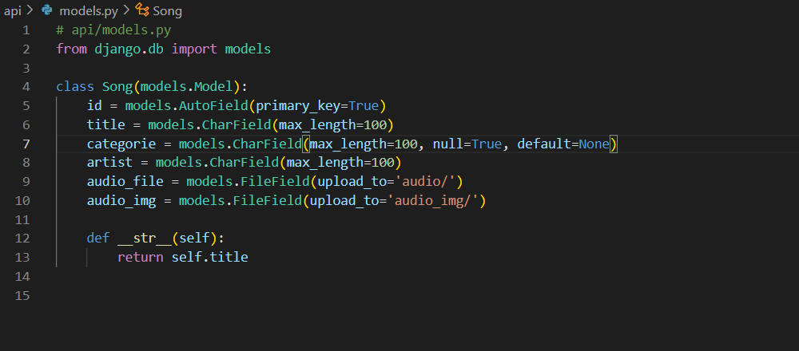
Next Gen Employability Program
Modelling & Results
Source :

Slide 9
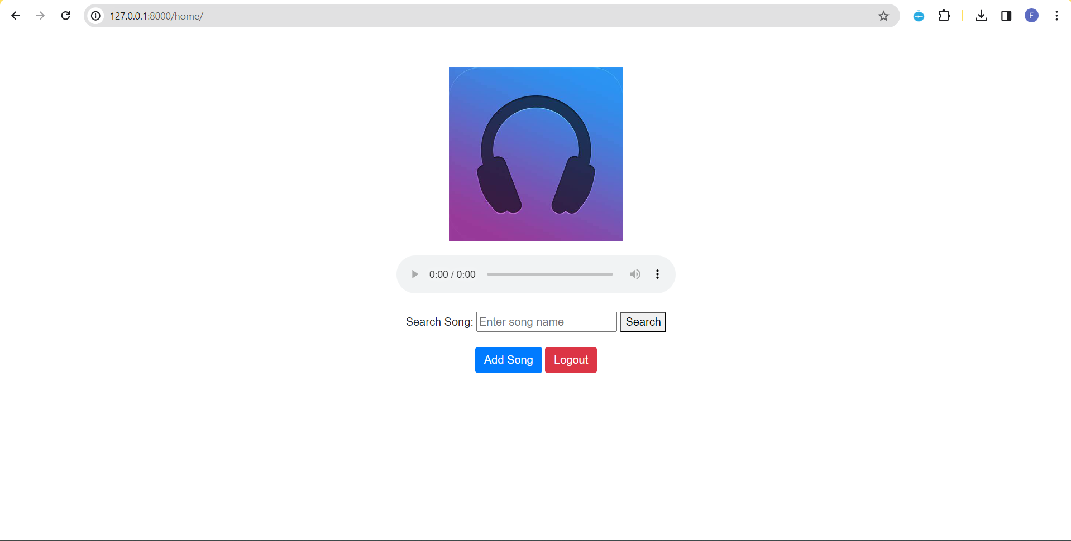
Next Gen Employability Program
Home-Page

Slide 10
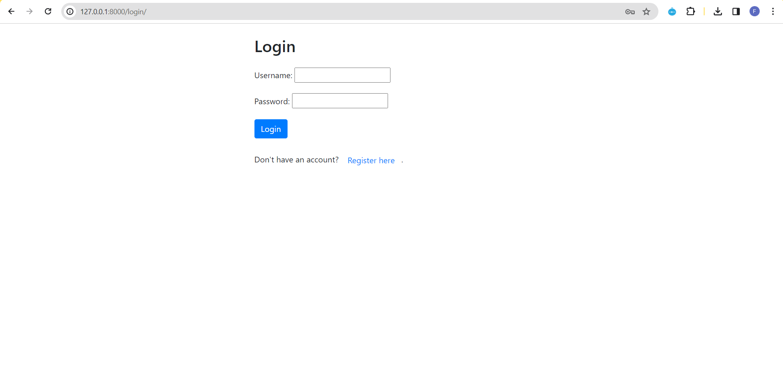
Next Gen Employability Program
Login-Page

Slide 11
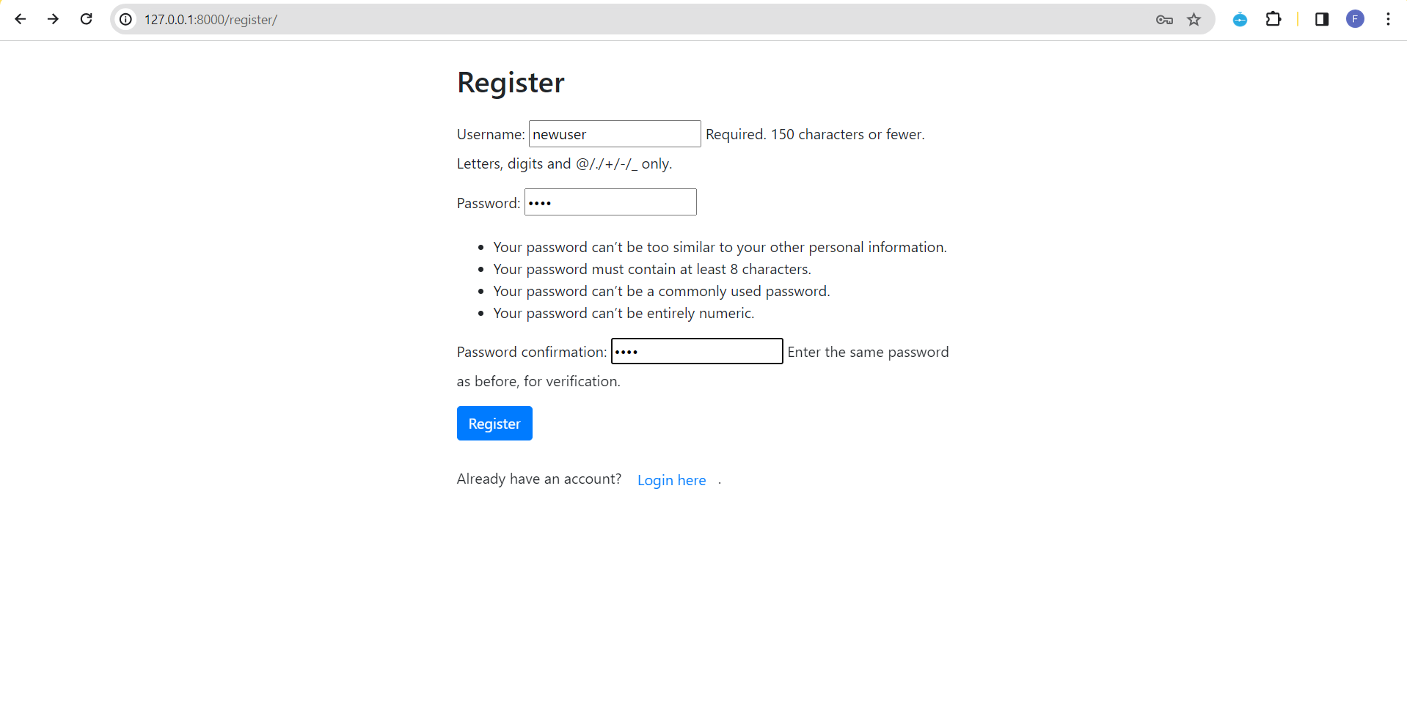
Next Gen Employability Program
Register-Page

Slide 12
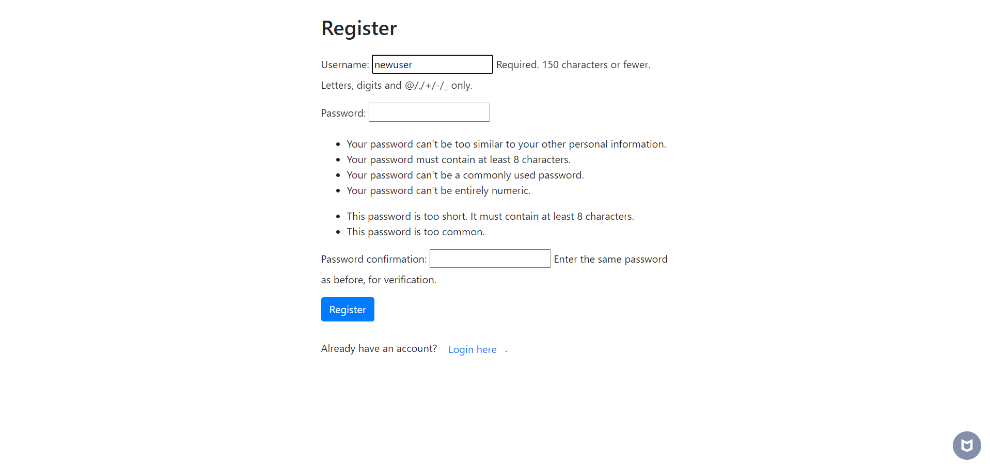
Next Gen Employability Program
Register-Page (with Invalid Password 1)

Slide 13
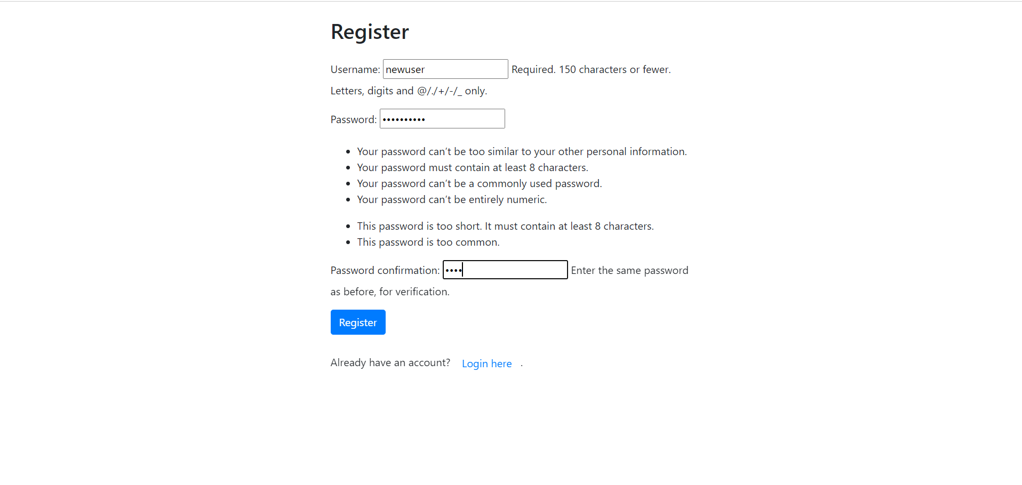
Next Gen Employability Program
Register-Page (with Invalid Password 2)

Slide 14
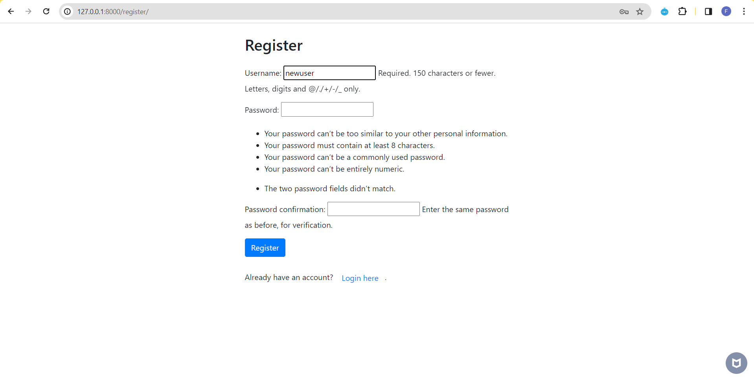
Next Gen Employability Program
Register-Page (with Invalid Password 3)

Slide 15
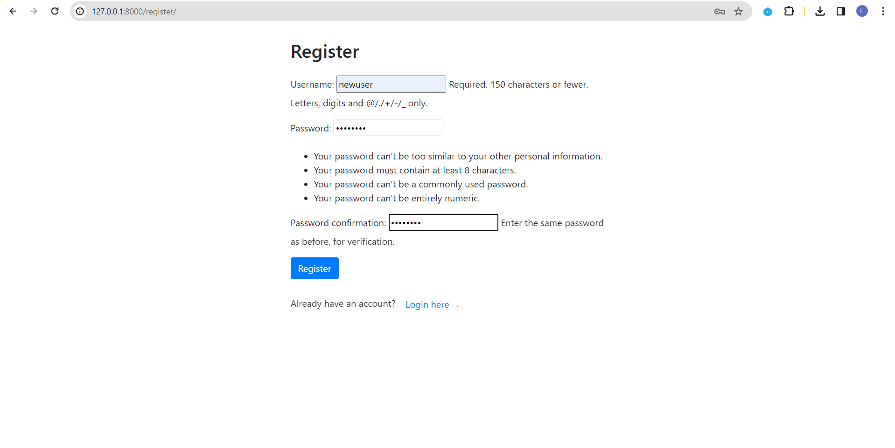
Next Gen Employability Program
Register-Page (with Valid Password)

Slide 16
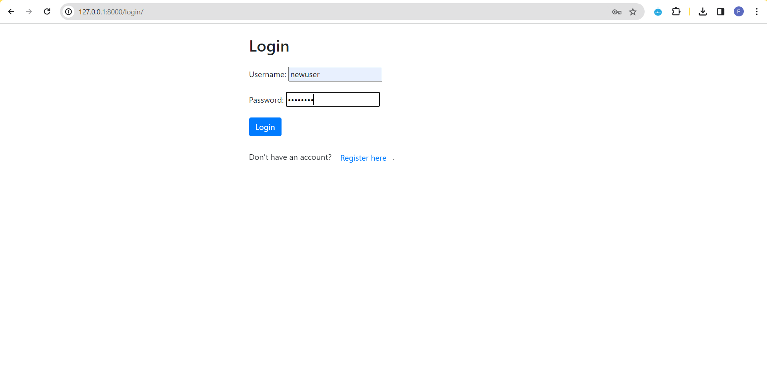
Next Gen Employability Program
Login-Page (after registration)

Slide 17
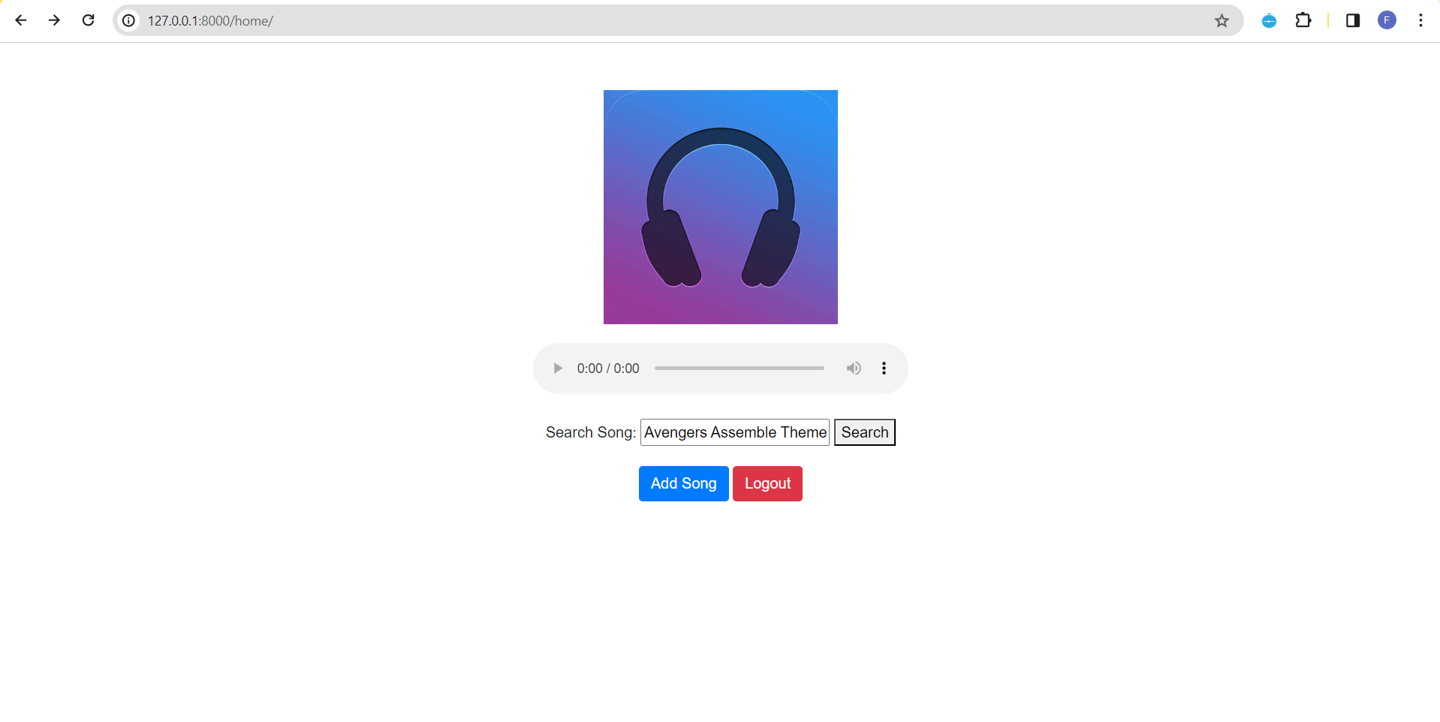
Next Gen Employability Program
Search-Song-Page

Slide 18
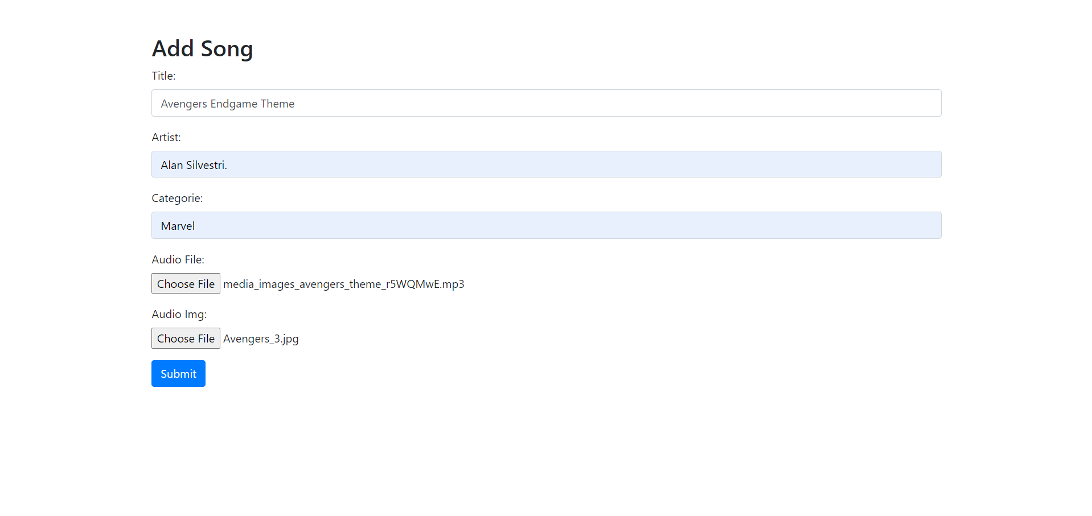
Next Gen Employability Program
Add-Song-Page

Slide 19
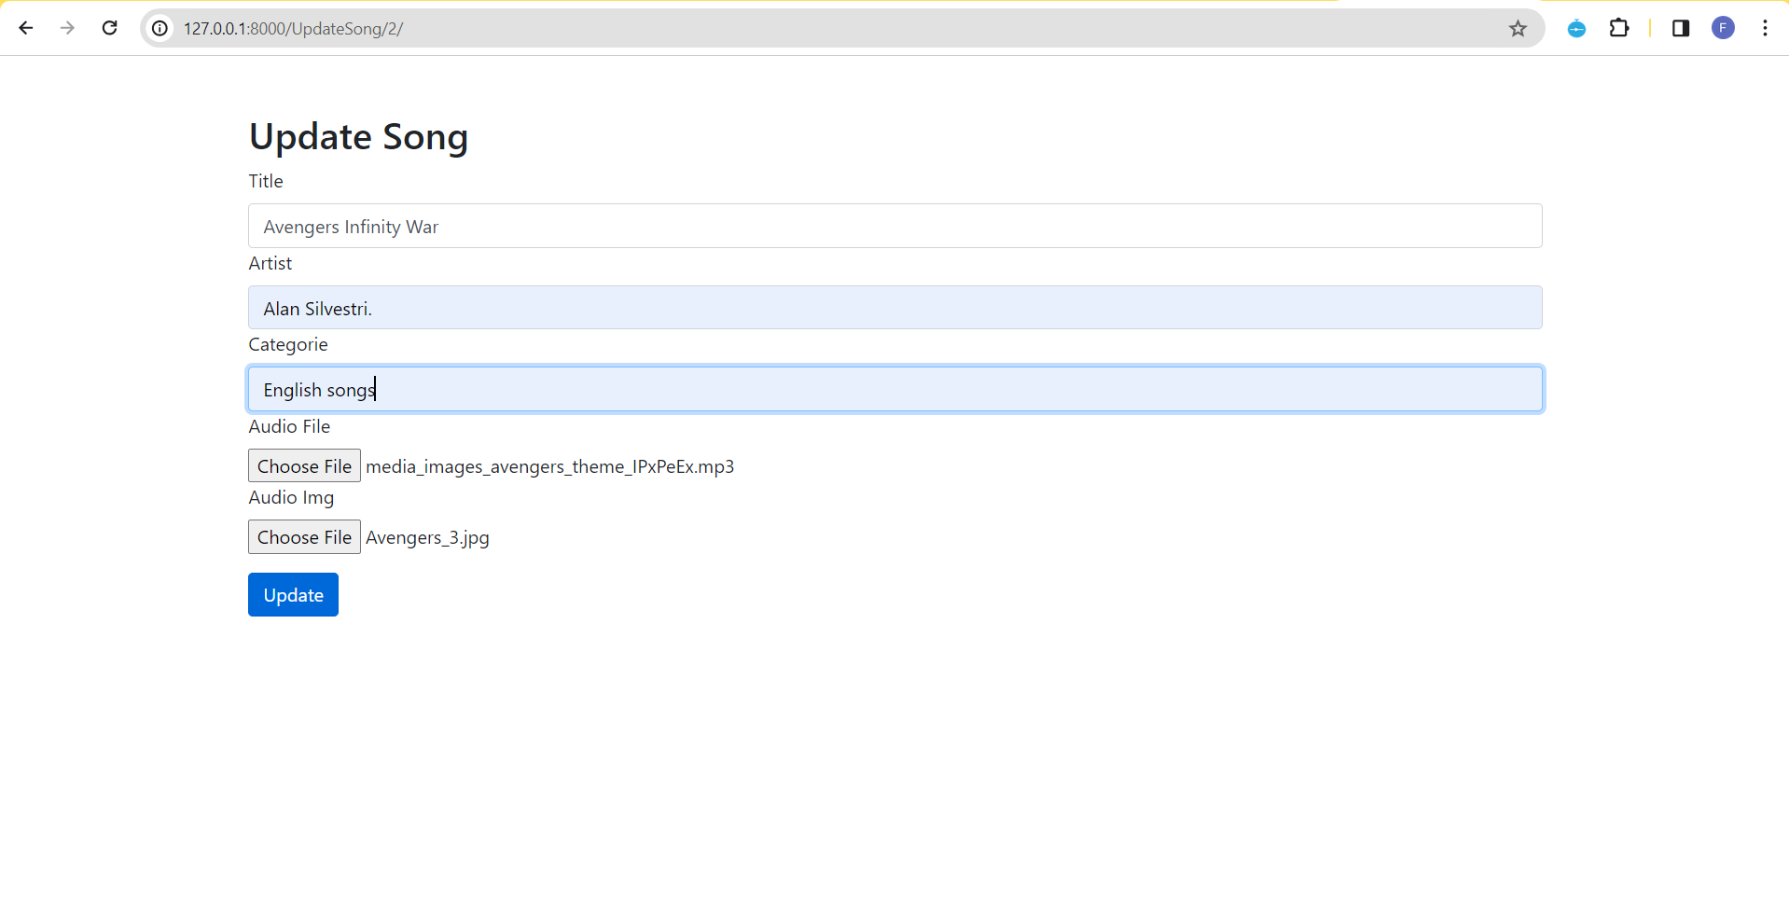
Next Gen Employability Program
Update-Song-Page

Slide 20
Next Gen Employability Program
Future Enhancements:
Improved UI Design: The UI of the music platform could be enhanced to make the web application more attractive and provide a better visual experience for users.
Multi-language Lyrics Support: Offer lyrics displayed in different languages for users to sing along and explore deeper meanings behind songs.
Artist Spotlight: Showcase emerging artists with curated playlists and exclusive content.
Improved Offline Mode: Enable bulk downloads for playlists and albums, with options for scheduled downloads.
Social Integration: Introduce user profiles, friend recommendations, and collaborative playlists for community engagement.

Slide 21
Next Gen Employability Program
Conclusion
In conclusion, Harmony offers a revolutionary platform for music enthusiasts to explore, discover, and enjoy their favorite tunes.
Addressing the need for a personalized and user-centric music streaming service, Harmony aims to redefine the way users engage with music.
With its free and accessible model, Harmony empowers users to embark on a journey of musical discovery without constraints.
Continuing to innovate and evolve, Harmony is committed to enhancing the user experience, providing an unparalleled audio journey that resonates with individual tastes and preferences. Music lovers are invited to join Harmony on this melodic adventure and harmonize the world of music together.
Source :

Slide 22
Thank You!
Next Gen Employability Program

